Slide 1




TECHNICAL EXIHIBITION Tinkering Lab
Chlorine Ions Detector Device

Slide 2

IDEA
Techno Spark
Problem Resolution :
We're democratizing water safety by providing lab-grade
testing at a fraction of the cost.
Our technology empowers rural communities to conduct their own water quality assessments.
Our solution overcomes literacy barriers with clear visual indicators and voice-guided instructions.
Overcomes limitations of existing methods ( high cost, complexity, interference).
Unique Value Propositions (UVP) :
Simple and standardized fabrication process.
Portable and suitable for on-site water quality monitoring.
Functions without need for sample pre-processing.
Specific to residual chlorine with minimal interference from other ions.
Low cost (estimated $0.03 per device).
IDEA / SOLUTION :
We are developing a portable, paper-based sensor using a graphene and PEDOT:PSS nanohybrid material to detect residual chlorine in water, enhanced with AI capabilities.
We present an innovative, portable nanohybrid paper- based sensor for precise residual chlorine detection.
Our cutting-edge design utilizes PEDOT:PSS and graphene
for superior sensitivity, accuracy and reusability.
We've integrated smartphone connectivity for instant, user-friendly digital results.
Our sensor detects chlorine levels as low as 0.1 ppm,
exceeding BIS 10500:2012 matches WHO standards.
We've minimized sample requirements to just 15 μL, making testing effortless for rural households.

Slide 3


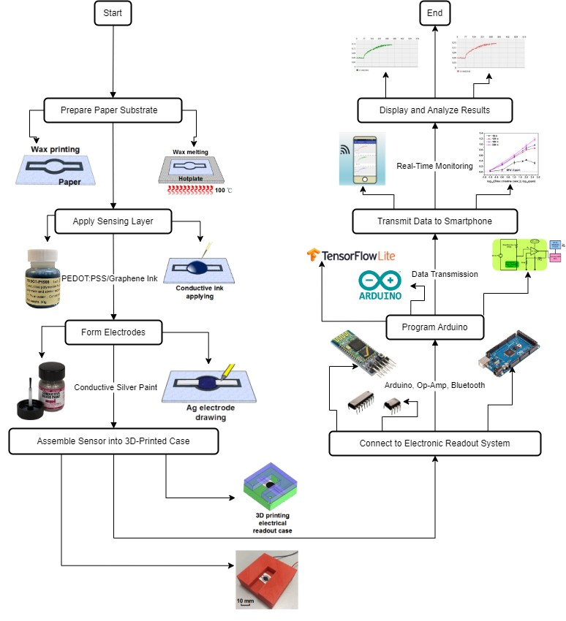
TECHNICAL APPROACH
Techno Spark

Slide 4
FEASIBILTY AND VIABILITY
Techno Spark
Technical Feasibility :
Scalability of Nanohybrid Sensors: The simple and standardized fabrication process of PEDOT/graphene hybrid sensors ensures scalability for mass production.
Smartphone Integration: Real-time chlorine detection through smartphones provides easy user interaction and data interpretation.
Simplicity in Design: Low-cost materials like wax-printed paper and conductive
silver paint make sensor design straightforward and easy to reproduce.
Financial Feasibility
Low Production Cost: The estimated cost of fabricating each sensor is approximately $0.03, making it highly cost-effective for mass distribution Minimal Maintenance: No specialized equipment is needed for sensor
maintenance, reducing long-term costs.
Market Feasibility
Demand for Water Quality Monitoring: The growing emphasis on water safety, particularly in developing regions, makes this solution viable in the market.
Wide Detection Range: The sensor's ability to detect chlorine concentrations
from 0.1 to 500 ppm covers various water quality needs (household, industrial).
Operational Feasibility
Portability: The paper-based design allows for easy transportation and on-site monitoring​.
Ease of Use: The solution requires no specialized training, making it accessible for non-expert users.
Potential Challenge and Risk:
Interference from Other Ions: Although the sensor is selective towards free chlorine, interference from ions like
hydroxides may pose challenges.
Signal Stability: Ensuring consistent Bluetooth signal
transmission in all environments is crucial.

Slide 5
IMPACT AND BENEFITS
Techno Spark
Benefits of the Solution
Social Benefits:
Improved access to water quality testing.
Empowers communities for independent monitoring.
Reduces health risks by ensuring safe chlorine levels.
Economic Benefits:
Increases productivity with simplified processes.
Cost-effective compared to traditional methods.
Expands market for affordable water testing solutions.
Environmental Benefits:
Energy Efficiency: Low energy requirements due to simple
fabrication and minimal electronic components.
Reduction in Waste: Paper-based, disposable sensors reduce electronic waste compared to traditional devices.
Sustainability: Encourages sustainable water management practices by making regular water quality monitoring feasible.
Potential Impact on the Target Audience
Positive Impact:
Improvement: Accurate, real-time chlorine detection for safe water.
Economical: Low-cost materials and fabrication.
New Opportunities: Access to on-site water testing in
rural/remote areas.
Social Benefits: Better public health, community empowerment.
Negative Impact:
Cost: Initial setup and scaling production costs.
Technology Adoption: Resistance and training needs in low-
resource settings.

Slide 6


